Slide 1
Implementation of symmetric algorithm modification system to resist power based side channel attacks

Slide 2

Do you know What is Side Channel attack ?

Slide 3
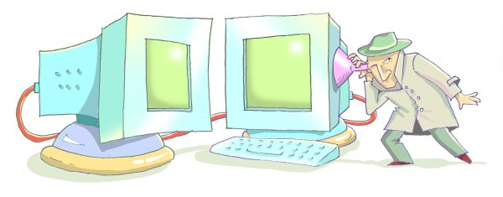

Slide 4
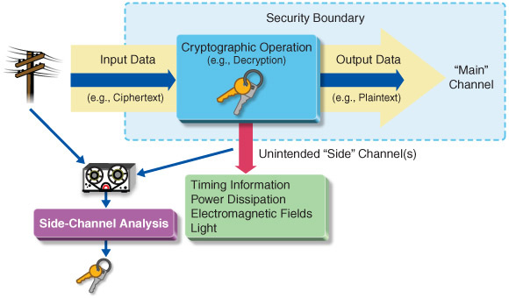
Side Channel Attack is ..
Any attack based on information gained from the physical implementation of a cryptosystem, rather than brute force or theoretical weaknesses in the algorithms.

Slide 5
Side Channel Attack is .. (Cont..)
These attacks based on “Side Channel Information “. Side channel information is information that can be retrieved from the encryption device that is neither the plaintext to be encrypted nor the ciphertext resulting from the encryption process.
That Side Information can be ,
Timing Information
Electromagnetic Radiation
Power consumption
Thermal Radiation
Acoustic Emanation

Slide 6

Why this Research Based On Power Consumption ?

Slide 7
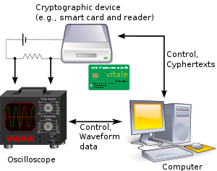
Power consumption analysis is one of the most effective and powerful methods.
Most frequently used method to collect side-channel-information by attacker and intruders
Power consumption analysis is also considered as one of the most reliable side-channel-information sources
power consumption is the most cost effective when compared with other methods of information gathering

Slide 8
Up to Now..
There are devices that are design to gather side-channel-information.
Can analyze side channel information to perform an attack.
Have the capability to derive the key through the attack.

Slide 9
Up to Now.. (Cont.…)
SASEBO (Side channel Attack Standard Evaluation Board)
CHIP WHISPERER
SAKURA-G FPGA

Slide 10
Problems Identified ..
There is no any product to find the vulnerable points in algorithm by analyzing power spike patterns.
There is no process to patch it automatically without altering the algorithm in order to mitigate side channel attacks.

Slide 11
How we mitigate side channel patterns?

Slide 12

Solution
Adding “RANDOMNESS” to the algorithm

Slide 13
Overall Idea

Slide 14
Extracting power consumption measurements

Slide 15
Data classification, analysis and module training

Slide 16
Automate Code embedding mechanism

Slide 17
Benefits

Slide 18
Capturing the Market

Slide 19


Slide 20

Questions ?

